Slide 1
Computational Chemistry
Lecture 10: Plane waves and core potentials

Slide 2
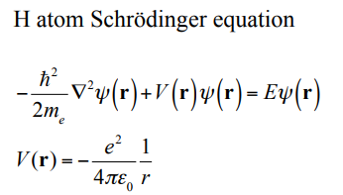
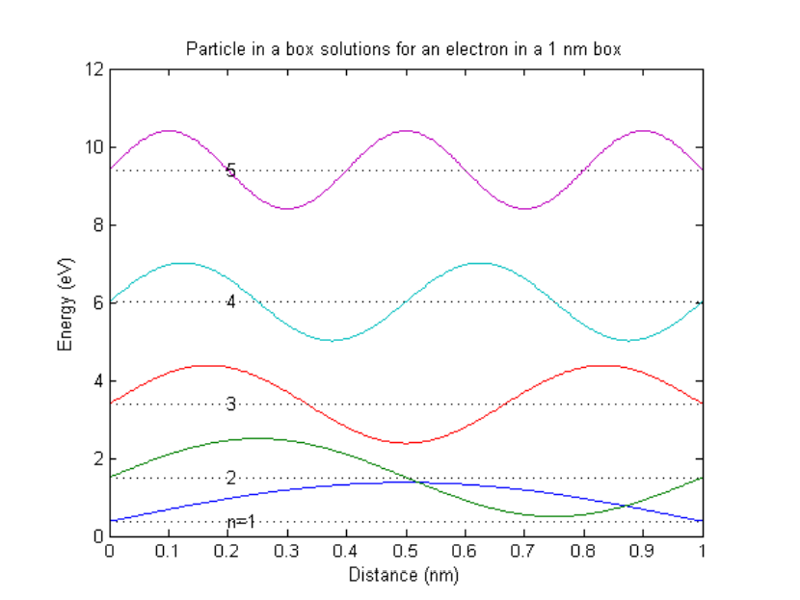
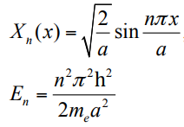
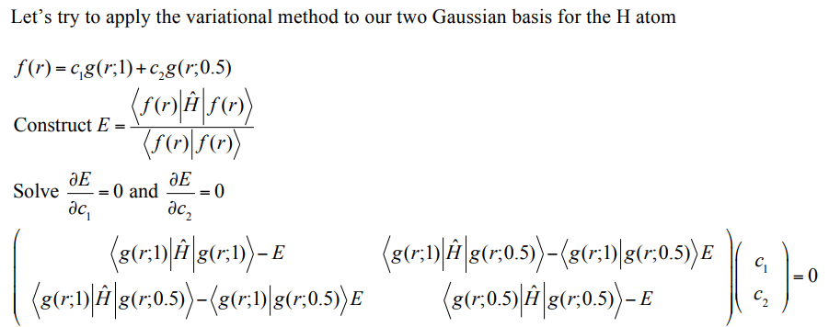
Plane waves
Place atom in a big box, if nucleus wasn’t there, we know what the solutions look like (1-D):
Could express H atom solutions as linear combinations of these. Not particularly efficient, but if it was really easy to evaluate matrix elements, might make sense to do.
Recall H atom problem in lecture 2:
We used Gaussian basis and variational method to get the wavefunction:
have to solve secular matrix containing matrix elements over basis functions

Slide 3
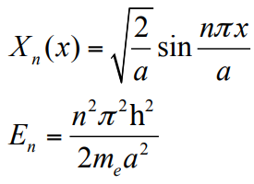
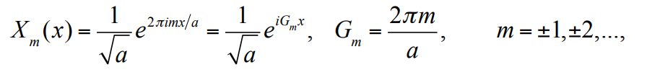
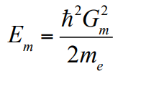
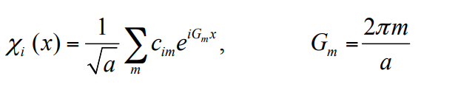
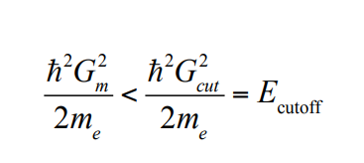
Plane waves
Rewrite waves as (apply periodic boundary conditions):
Can write solutions for H atom as linear combination of these “plane wave” basis functions:
If we let m run to infinity we would have a “complete” basis and could represent the H orbital exactly. In general we can’t keep an infinite number of m, so have to cut off somewhere, defined by

Slide 4
Gaussian vs. Vasp
PW91 H atom | Gaussian | Vasp
Basis set | 6-311G(d,p) | Plane wave, 250 eV cutoff
Number of basis functions | 6 basis functions | 9045 basis functions
Number of cycles to converge | 3 cycles to converge (good initial guess) | 15 cycles to converge (initial plane wave guess more difficult)

Slide 5
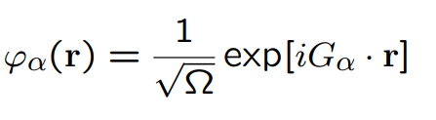

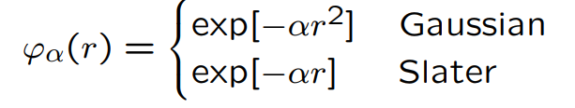
Atomic orbital basis sets vs. Plane waves
AO basis sets: Molecules are assemblies of slightly distorted atoms
Basis functions are attached to nuclear positions
+ according to chemical insight
+ small basis sets give already good results
– non-orthogonal
– depend on atomic position
Plane waves: Assemblies of atoms are slight distortions to free electrons
+ orthonormal
+ independent of atomic positions
± naturally periodic
– many functions needed
– localized functions difficult to represent

Slide 6
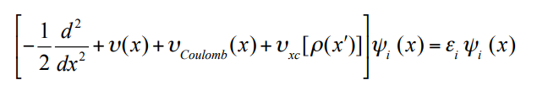
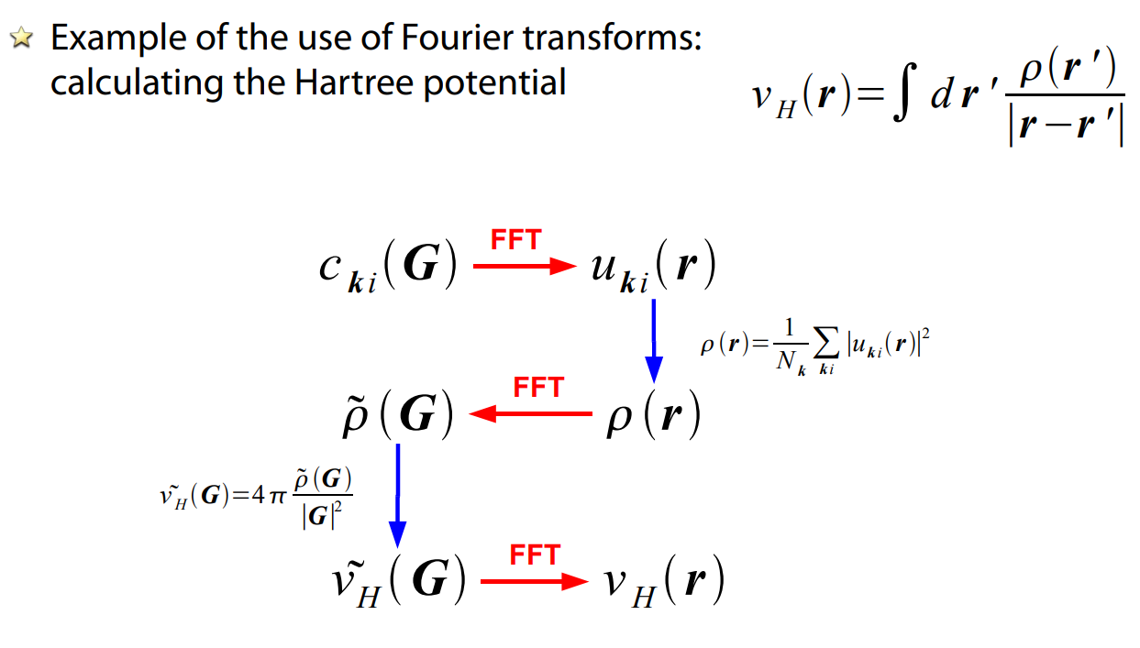
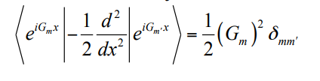
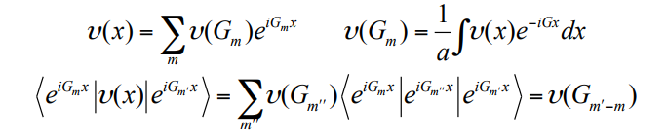
Plane waves in DFT
Kinetic energy: Diagonal in basis functions
Potential energy terms: Can take advantage of Fourier transforms to evaluate:
x: real space
G: reciprocal space
François-Xavier Coudert, “DFT with plane waves, pseudopotentials” http://www.phenix.cnrs.fr/IMG/pdf/dft-pw.pdf

Slide 7
Plane waves: Summary
Plane waves are delocalized, periodic basis functions
Plenty of them are needed, however the operations are simple
The quality of basis set adjusted using a single parameter, the cut-off energy
Fast Fourier-transform used to efficiently switch between real and reciprocal space
The size of basis set is independent of number of atoms (for a given volume)

